Slide 1




Classification of handwritten digits using RBM, SOM and
Irina Petrakova-Otto
Spencer Kieffer
Becky Ling

Slide 2
Approach and Methodology
MNIST dataset of handwritten digits was used (MNIST handwritten digit database, Yann LeCun, Corinna Cortes and Chris Burges) and processed using TensorFlow library.
The algorithms were evaluated for accuracy using different datasets size and network parameters.

Slide 3

Self-organizing Maps
Irina Petrakova-Otto

Slide 4
Self-Organizing Maps (SOM)
Unsupervised learning artificial network algorithm
Feature Reduction
Competitive learning instead of error reduction

Slide 5
SOM: Accuracy
Observations:
The accuracy is deeping when epoch: 10 and 15
For different datasets, the 20x20 has the lowest accuracy on 10 and 15 but highest on 20 iterations
The accuracy is over 80% on unseen data after 20 iterations
Epoch | Accuracy
 | (10x10) (10000/4000) | (20x20) (10000/4000) | (10x10) (1000/400) | (20x20) (1000/400)
5 | 0.21375 | 0.10550 | 0.3350 | 0.3650
10 | 0.19475 | 0.04425 | 0.1750 | 0.0925
15 | 0.41275 | 0.06 | 0.2225 | 0.0375
20 | 0.83500 | 0.87600 | 0.8025 | 0.84

Slide 6
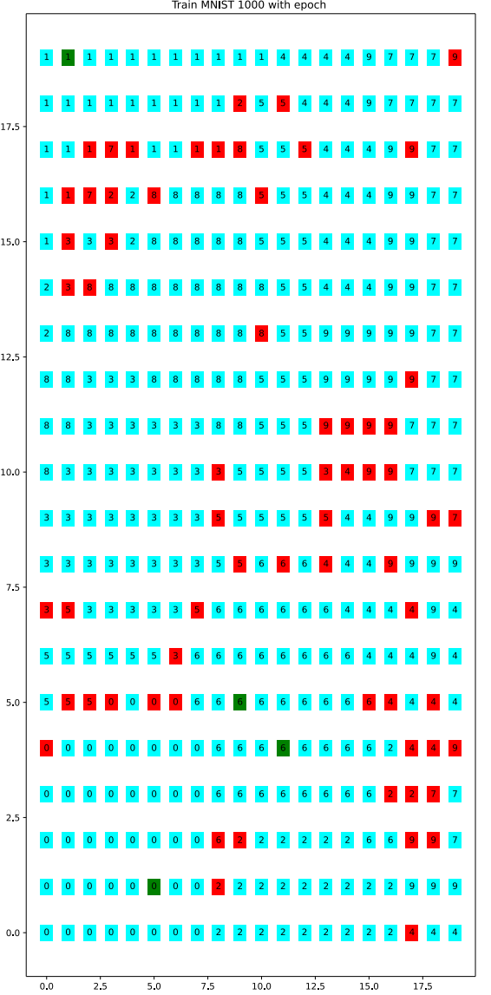
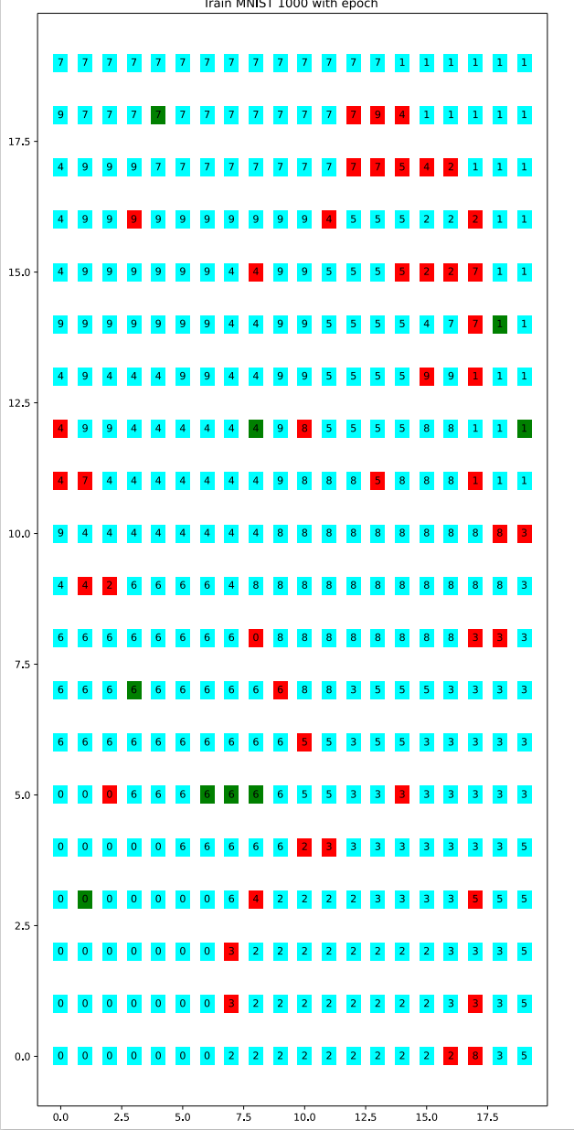
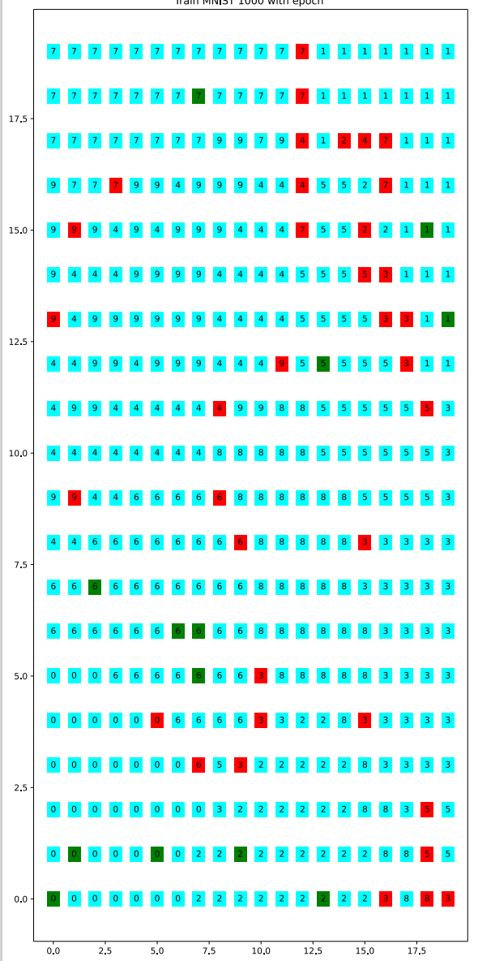
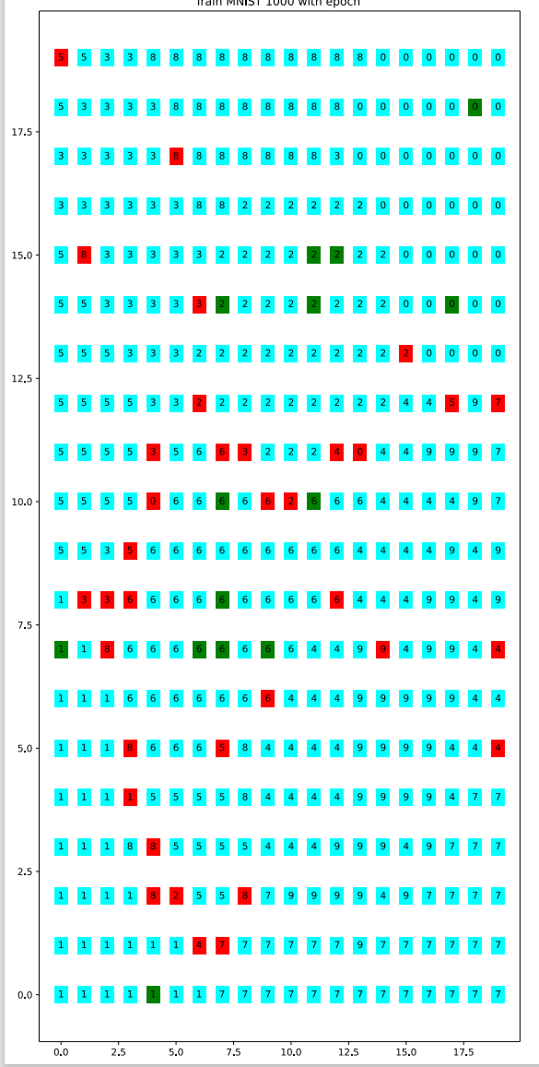
SOM: 20x20: training size:10000: Clustering & Classification
Pr(digit)=100%
50%<=Pr(digit)<100%
Pr(digit)<50%
Epoch:5
Epoch:10
Epoch:15
Epoch:20

